Slide 1

Semiconductor Visualization
Hanoi University of Science and Technology
School of Information and Communication Technology
Object-oriented Programming – 20192

Slide 2
Team members & Assignments
Name | Student ID | Tasks
Trinh Thu Hai | 20184255 | Design ideas Design class diagram & use-case diagram Implement backend codes Test backend Suggest modifications to frontend Integrate frontend and backend code
Nguyen Thi Minh Chau | 20184238 | Design ideas Design class diagram & use-case diagram Implement frontend codes & design GUI Test frontend and GUI Suggest modifications to backend Final test Write documents, preparing video & presentation slides.
Notes:
As you can see here, this is out assignment for each team member for the last 6 weeks
In the 1st and a half week, we designed the ideas for the application, as well as defining the use-case and relationship between classes.
After that, we divide the coding part into backend code, which is done by Hai, and front-end with GUI, which I have taken on.
Finally, Hai is in charge in integrating these both together, while I preparing the documentation, as well as the presentation.
In the whole process, we usually discuss together to suggest solutions to each other work.

Slide 3
PROBLEM STATEMENT
Object-oriented is a new programming method which is convenient but difficult for new learners to master.
The aim of the project is to use this technique to build a program for visualizing fundamental working principles of semiconductors materials – not only for applying knowledge in OOP to real application, but also to give a better knowledge for learner about semiconductors.
Notes:
The aim behind this choice is because of 2 things: The new concepts of OOP to each of us, and the complicated working principle of semiconductors.
We want to combine these things in order to make an application that helps student to have a better insights on this material.
And this is our problem statement

Slide 4
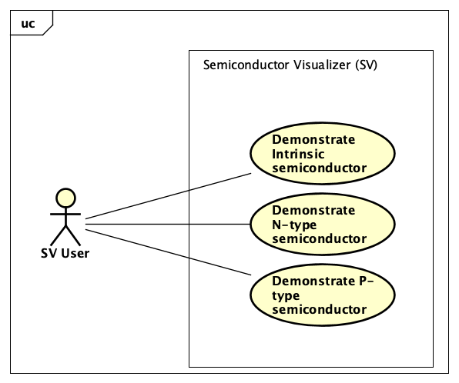
Notes:
Here is the use case diagram of our project. As you can see here, Semiconductor Visualizer help user demonstrate 2 types of materials: Intrinsic, which is also known as
Pure semiconductor, N-type, which has the main conductor particle is electron, and P-type, which has the main of which is hole with positive charge.
In each use-case, User do a chain of action, including choosing the dope level of the semiconductor, as well as adjusting external parameters: output voltage and temperature

Slide 5
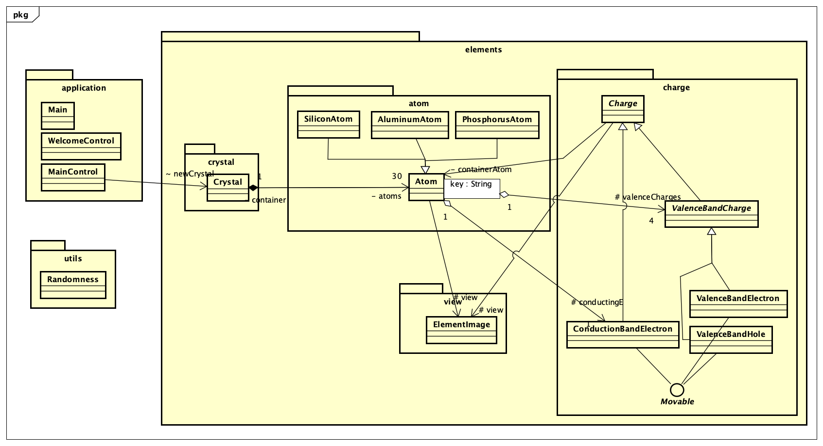
Notes:
This is an overview of the packages of the program. You can see that, here we have 3 main packages: elements, which include the main code of the program
Application, for the GUI, and utils for some additional methods of the application
And now, Hai will present to you in detal about each package with classes
****
Mainframe: Crystal, Atom, Charge
there is only electron, but use 3 types of charge:
Semiconductor crystal: always 4 position for electrons in atom shell - “up, down, right, left”
> 4: free electron — does not bond
< 4: hole — gap
not in motion: valence electron
in motion: free e
in restricted motion: hole
hole & valence e: part of shell, 1/4 position —> valencebandelectron
free e: not part of shell
Implemetation:
hashmap of valencebandcharge
list of conductionbandcharge
****
Create a timeline: for each time step:
Crystal.progress()
call methods of Atom:
1. check conditions: 1.1. components of charge
1.2. environmet parameters: for stochasticity (Ex.)
2. chose 1 of 4 or do nothing: Atom.passOnConductingE(),.exchangeHoleWithElectron(), .diffuse(), .recombination()
call methods of charges: *.moveChaotic, moveTranslate, moveArc, moveOutFrameAndBack, spin, appear (Movable interface)
****
representing pure, N-type, P-type atom: PA, SA, AA (cóntructor w/ components)
Crystal.init() —> distribute diff types
***
other classes
Controllers: mainCOntrol: call crystal.init() (bind crystal attr w/ GUI components) && crystal.progress()
randomness: utility for crystal.init()
elementImage: GUI components of atoms & charges

Slide 6
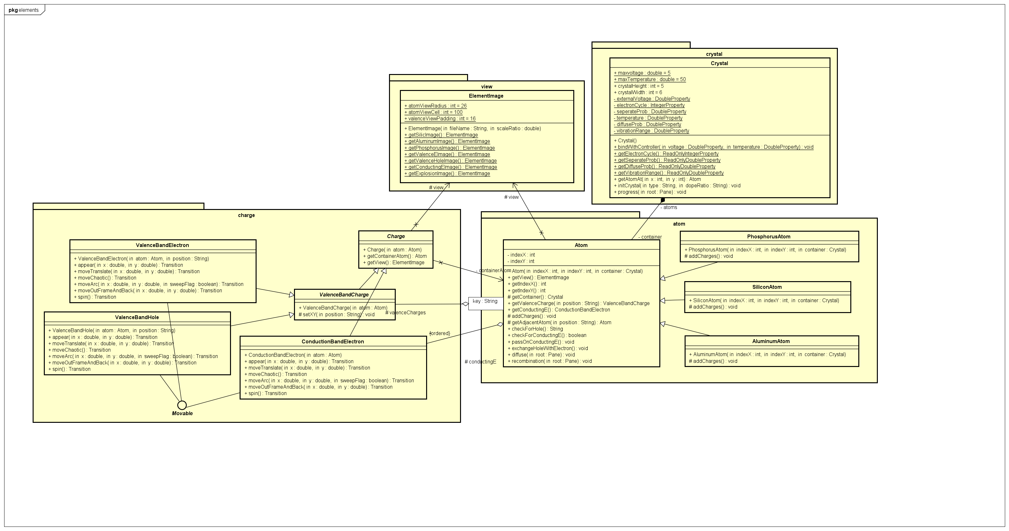
Notes:
****
Mainframe: Crystal, Atom, Charge
there is only electron, but use 3 types of charge:
Semiconductor crystal: always 4 position for electrons in atom shell - “up, down, right, left”
> 4: free electron — does not bond
< 4: hole — gap
not in motion: valence electron
in motion: free e
in restricted motion: hole
hole & valence e: part of shell, 1/4 position —> valencebandelectron
free e: not part of shell
Implemetation:
hashmap of valencebandcharge
list of conductionbandcharge
****
Create a timeline: for each time step:
Crystal.progress()
call methods of Atom:
1. check conditions: 1.1. components of charge
1.2. environmet parameters: for stochasticity (Ex.)
2. chose 1 of 4 or do nothing: Atom.passOnConductingE(),.exchangeHoleWithElectron(), .diffuse(), .recombination()
call methods of charges: *.moveChaotic, moveTranslate, moveArc, moveOutFrameAndBack, spin, appear (Movable interface)
****
representing pure, N-type, P-type atom: PA, SA, AA (cóntructor w/ components)
Crystal.init() —> distribute diff types
***
other classes
Controllers: mainCOntrol: call crystal.init() (bind crystal attr w/ GUI components) && crystal.progress()
randomness: utility for crystal.init()
elementImage: GUI components of atoms & charges

Slide 7
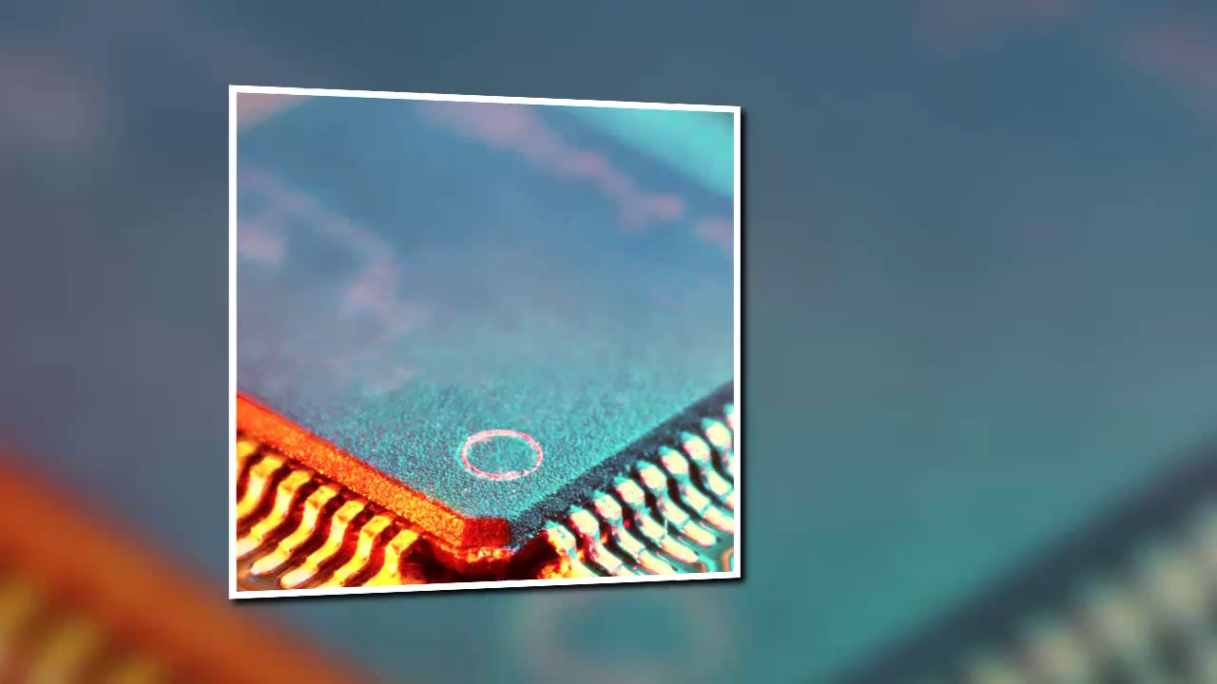
Notes:
Demo video with link

Slide 8
Questions & Answers

Slide 9


